Slide 1
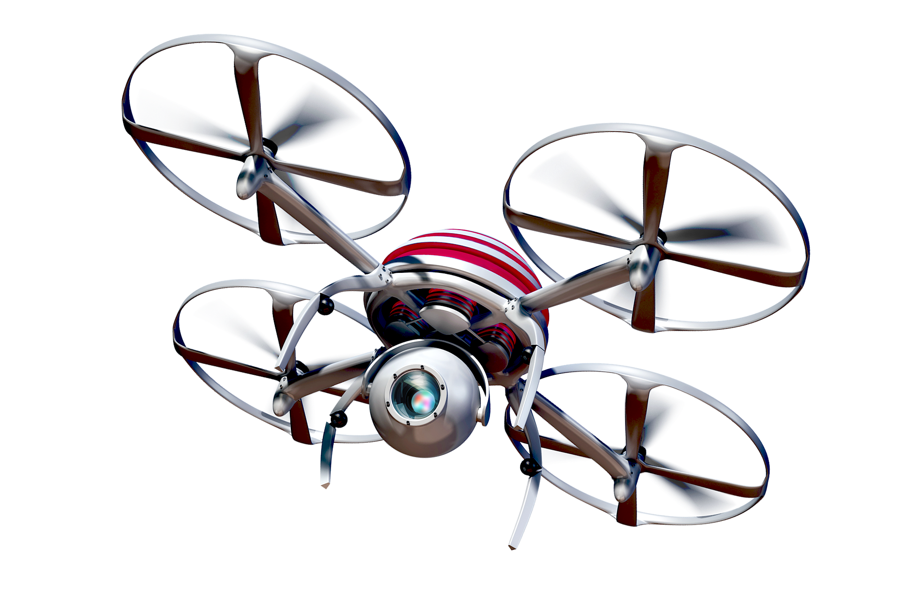
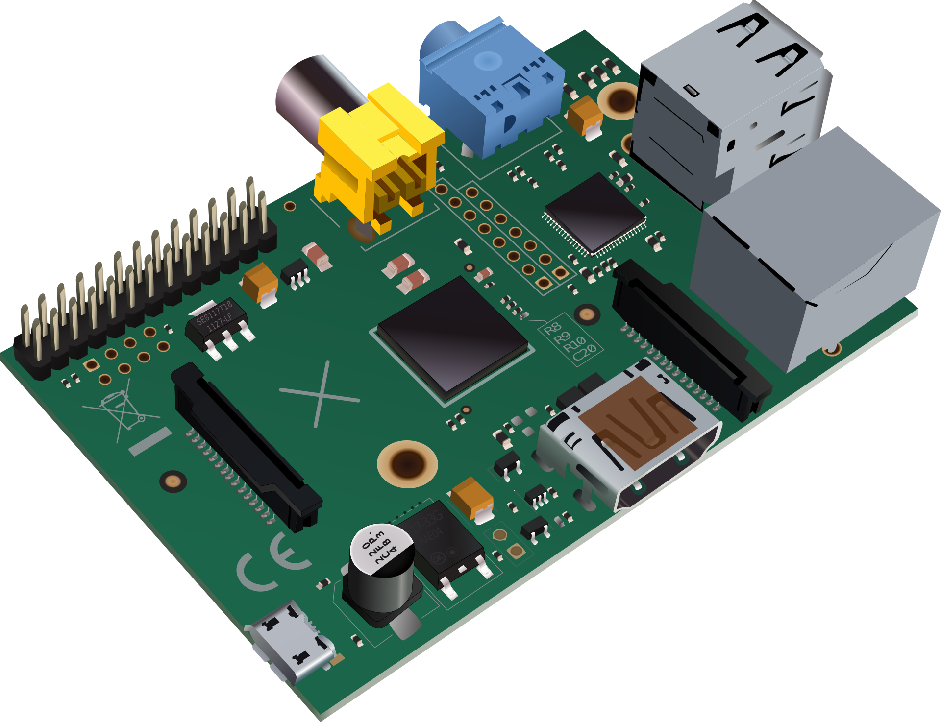

Slide 2

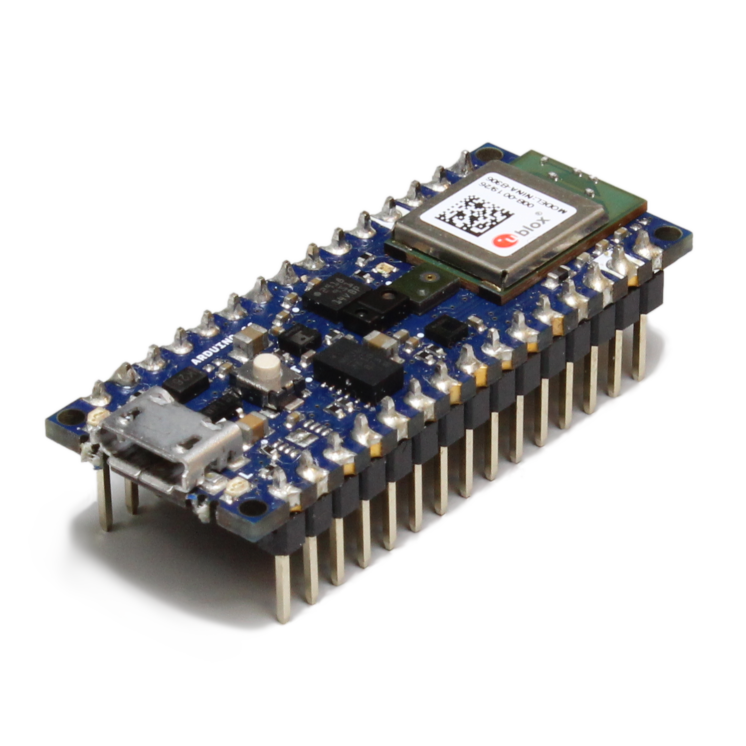

Single Board Computer
More powerful (faster processor, more memory)
Runs full, general purpose operating system (OS)
Can provide full command line or graphical user interface
Requires more power
Microcontroller
Less powerful
Bare-metal (superloop) or real-time operating system (RTOS)
Limited or no user interface
Requires less power

Slide 3
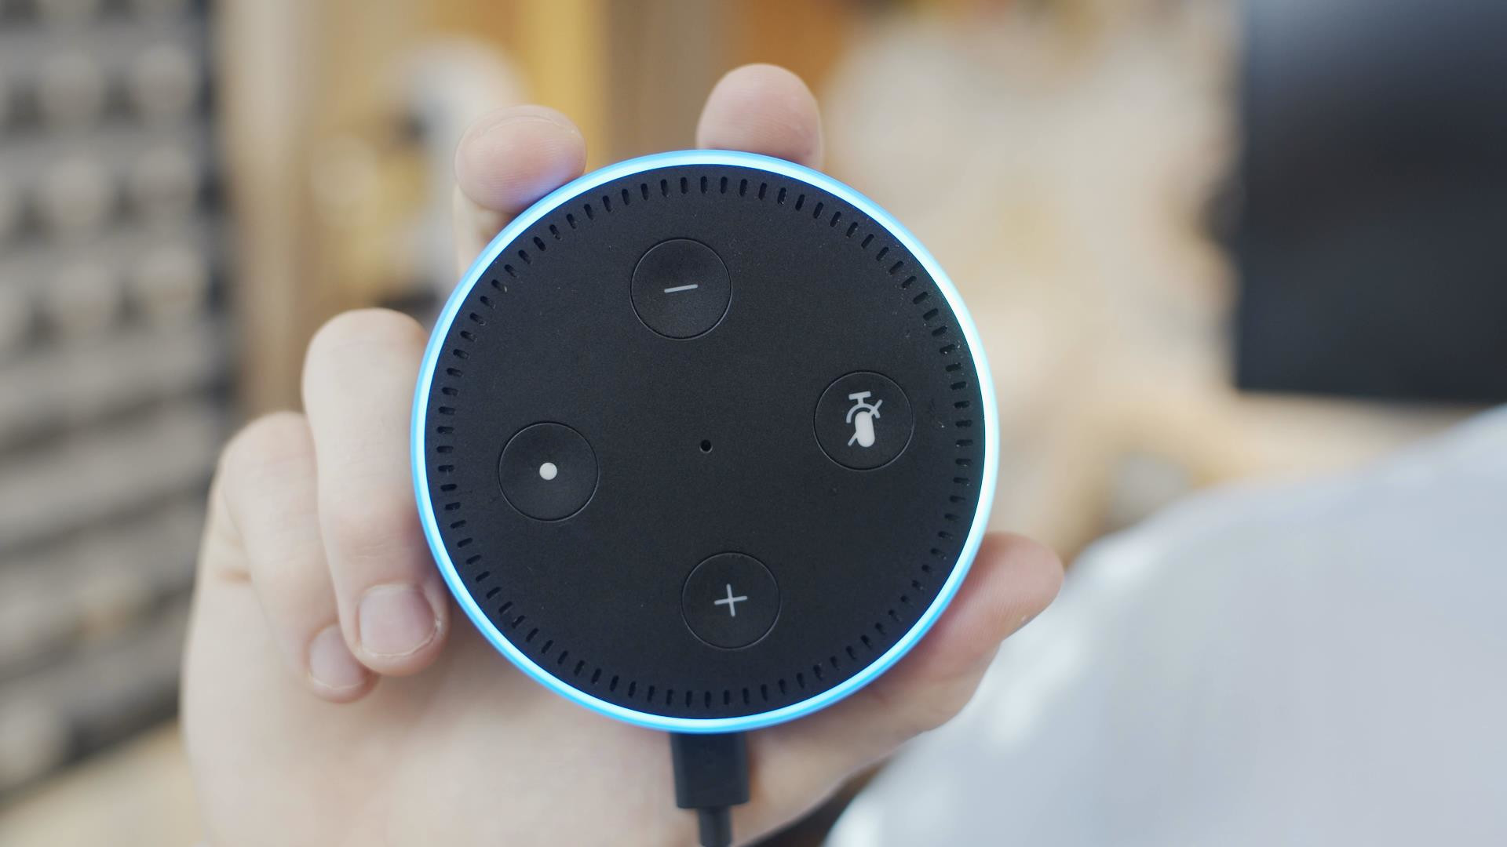
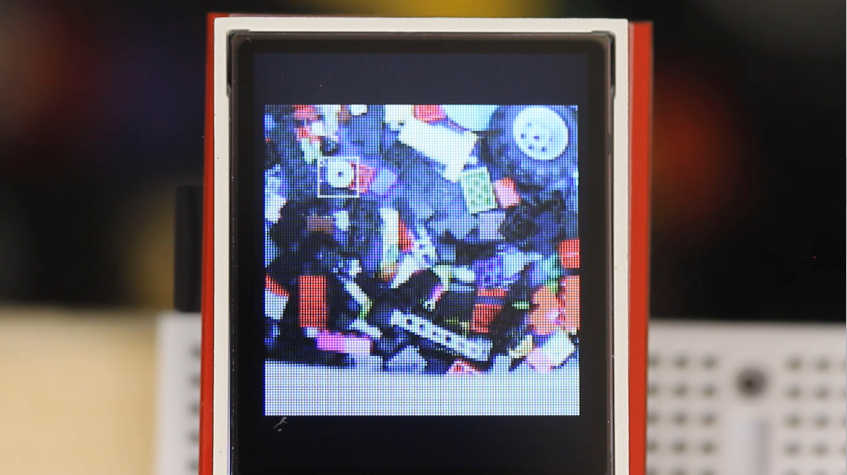

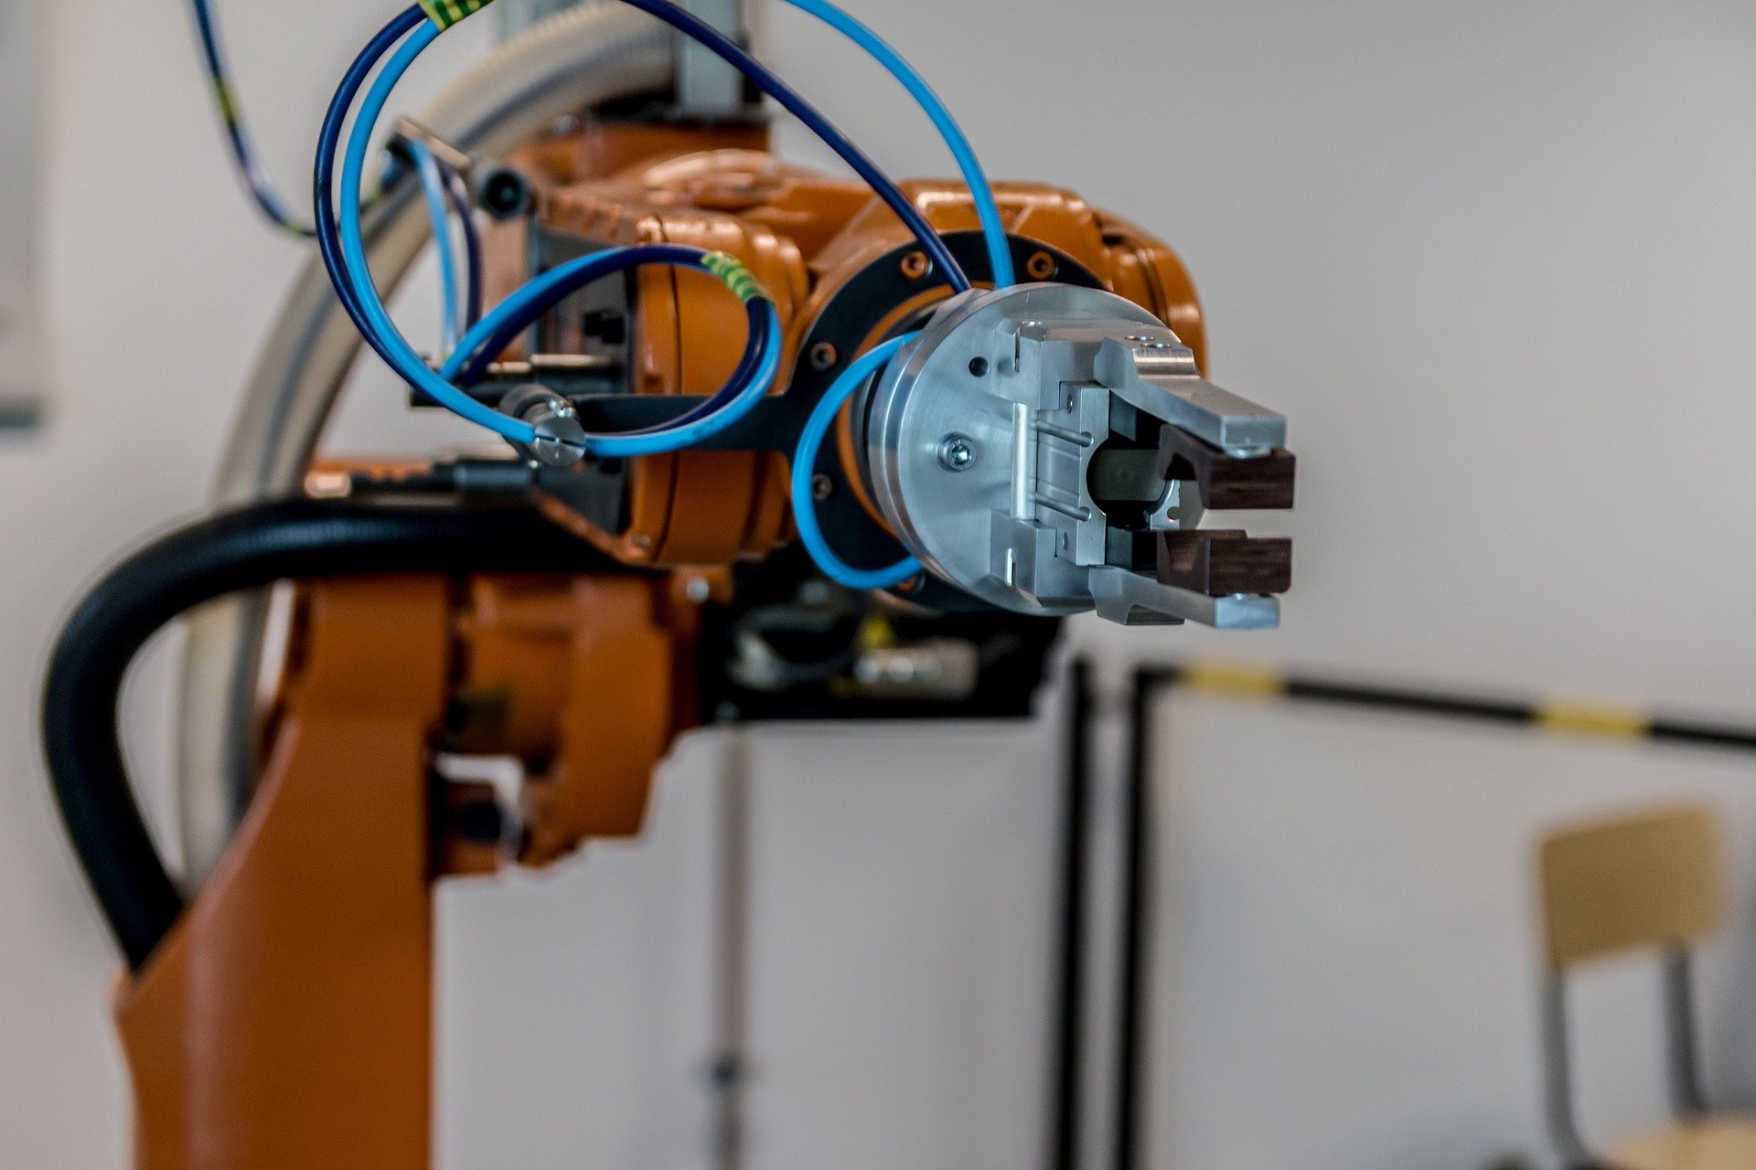

Slide 4


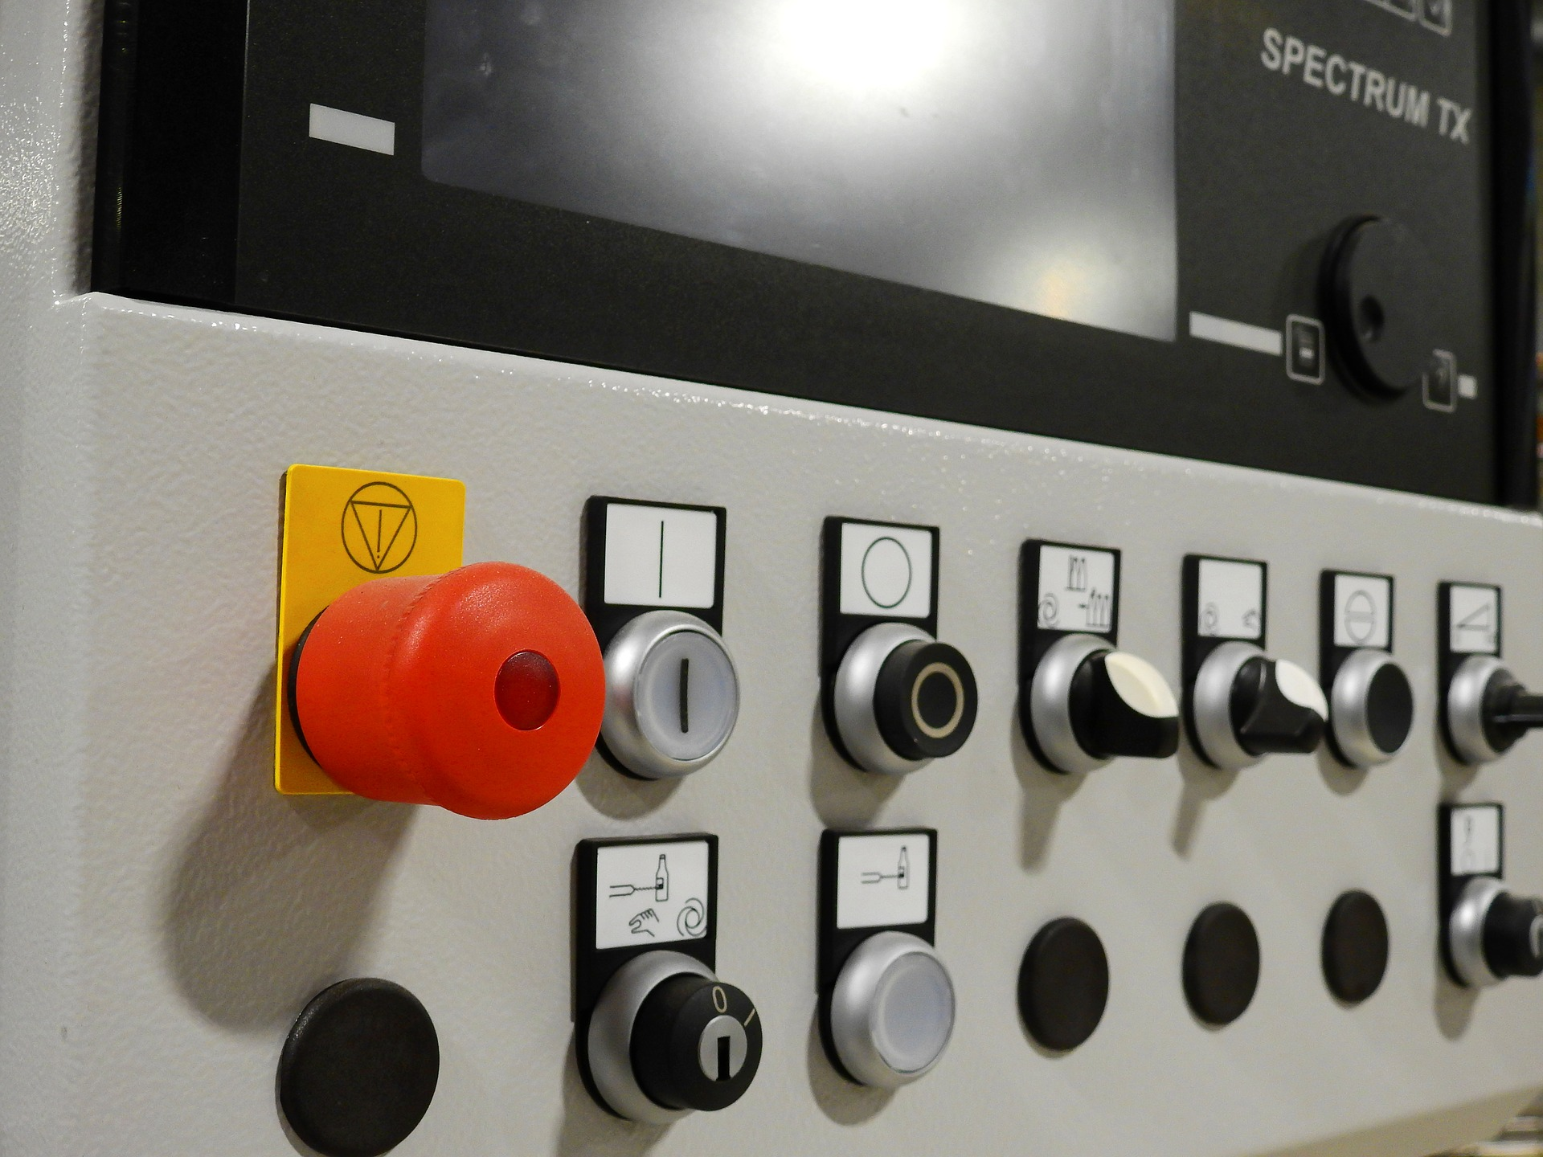

Deterministic
Probabilistic
“stop”

